Slide 1
Digital Portfolio
STUDENT NAME: Nivetha R
REGISTER NO AND NMID: astvu346m24397
DEPARTMENT: Bachelor of computer application
COLLEGE:MMES women’s art’s and science college, melvisharam /UNIVERSITY:Thiruvalluvar university

Slide 2
PROJECT TITLE
Empowering Education with digital portfolio

Slide 3
AGENDA
Problem Statement
Project Overview
End Users
Tools and Technologies
Portfolio design and Layout
Features and Functionality
Results and Screenshots
Conclusion
Github Link

Slide 4

PROBLEM STATEMENT
1. Skill Showcase Gap Traditional resumes fail to capture creativity, skills, and real-world projects, leaving students unable to demonstrate their true potential.
2. Lack of Online Presence
Many students lack a structured digital space to highlight achievements, creating a barrier between talent and opportunities.
3. Outdated Methods
Certificates and CVs are static, offering limited engagement in a digital-first world

Slide 5
4. Accessibility & Visibility
Without a dynamic platform, student achievements remain unnoticed, reducing chances for growth and recognition.
5. Talent-Opportunity Mismatch
The absence of interactive portfolios widens the gap between what students can do and what recruiters/academics can see

Slide 6
PROJECT OVERVIEW
This project focuses on creating a Digital Portfolio as an innovative tool to empower education. The portfolio serves as a personal space where students and professionals can showcase their skills, achievements, academic projects, and personal growth journey in an organized digital format.
The portfolio contains the following sections:
About Me - Introduction, background, and goals.

Slide 7
Projects - Key academic or professional projects with descriptions and outcomes.
Skills - Technical, academic, and soft skills represented effectively.
Contact - Easy ways for teachers, peers, or employers to connect.
The main idea is to encourage self-learning, creativity, and confidence by giving individuals a platform to present their work digitally. This not only enhances communication skills but also helps in career readiness, higher education opportunities, and personal branding

Slide 8
WHO ARE THE END USERS?
Students - showcase skills & achievements.
Teachers - assess learning & give feedback.
Employers/Recruiters - evaluate candidates.
Institutions - highlight student progress.
Primary end users = Students

Slide 9

TOOLS AND TECHNIQUES
LMS: Google Classroom, Moodle
Portfolio Apps: Seesaw, Mahara, Portfolium
Cloud & Collab: Google Drive, OneDrive, Teams
Creative Tools: Canva, Padlet, Wakelet
Feedback Tools: Kahoot, Mentimeter

Slide 10
TECHNIQUES
Student-centered & reflective learning
Project-based learning
Goal setting & skill tracking
Peer review & collaboration
Showcasing achievements & career readiness

Slide 11
POTFOLIO DESIGN AND LAYOUT
Header: Navigation bar
About Me: Education + career goals
Skills Section: Academic & technical skills
Projects Showcase: Images + details
Achievements/Certificates: Awards & recognition
Reflections: Learning journey & growth
Contact Section: Email, phone, Linkedin

Slide 12

Simple, clear structure that
empowers learners
by showing skills, growth,
and achievements.

Slide 13
FEATURES AND FUNCTIONALITY
Features of Digital Portfolio
1. Stores and showcases student work (text, images, videos, projects).
2. Provides real-time feedback and progress tracking.
3. Accessible anytime, anywhere (cloud-based). 4. Supports personalization and easy sharing.
Functions in Empowering Education
1. Encourages self-reflection and ownership of learning.
2. Showcases skills beyond grades.
3. Enhances motivation, creativity, and engagement.

Slide 14
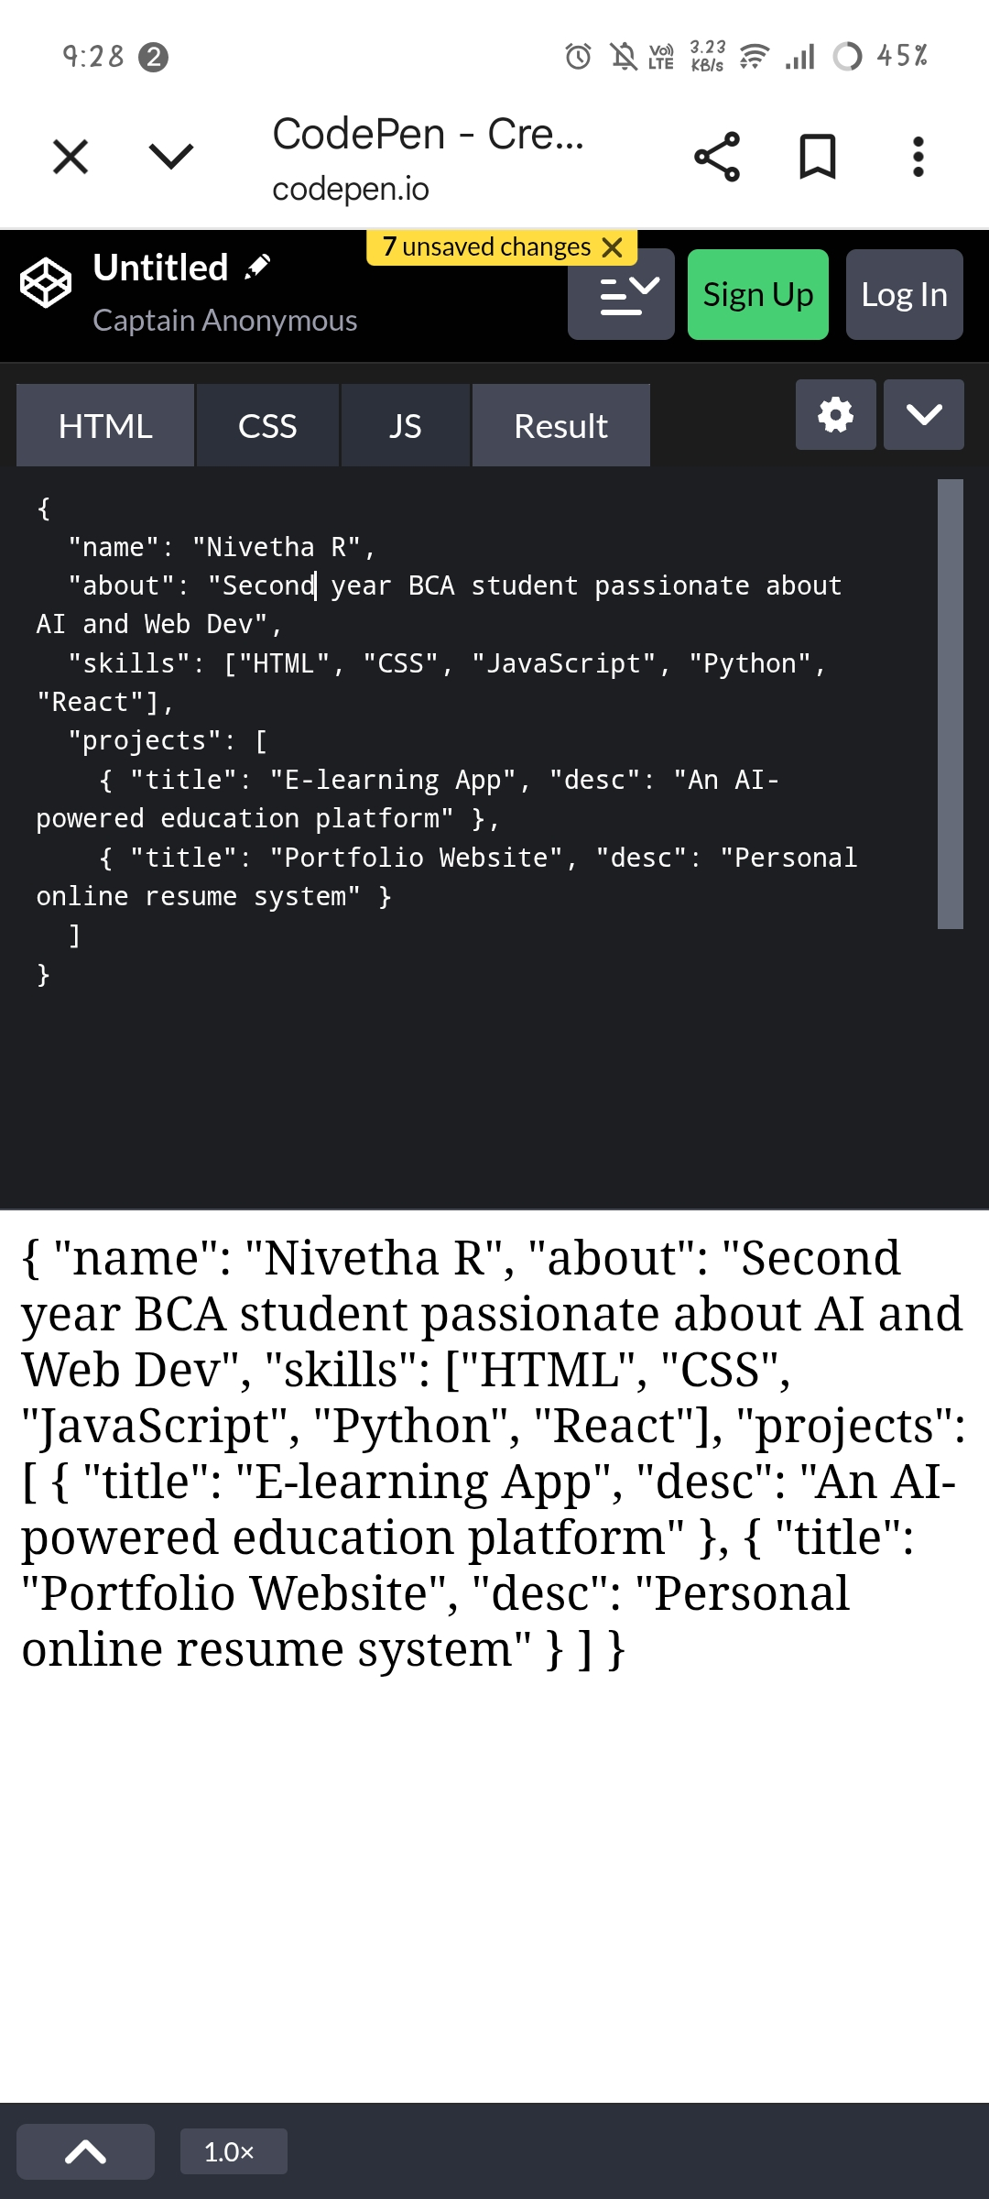
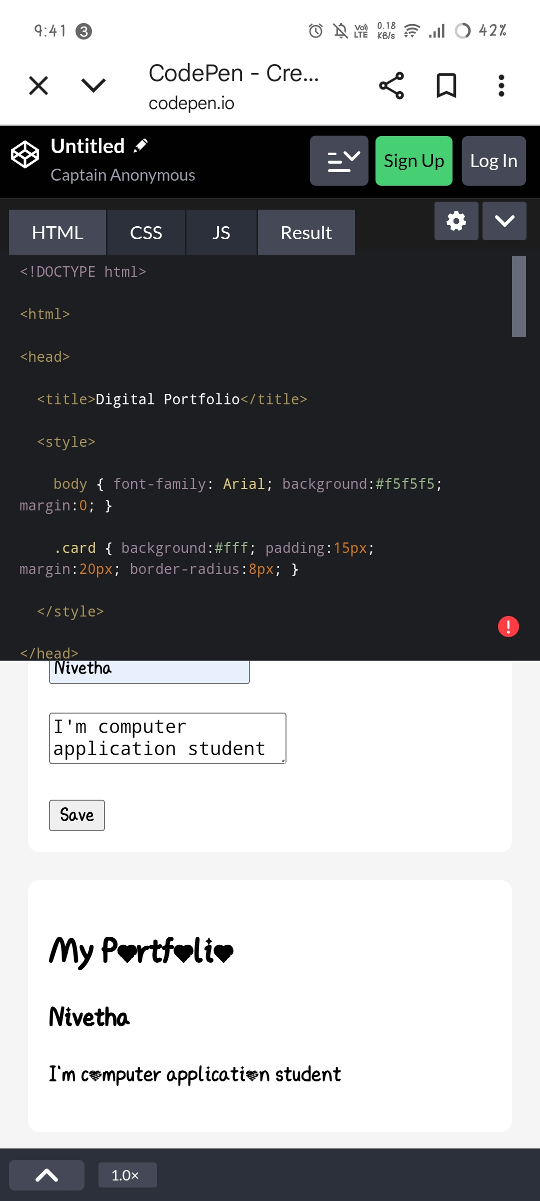

RESULTS AND SCREENSHOTS
Screenshot of each section

Slide 15
CONCLUSION
Finally, I finished my digital portfolio project using HTML,CSS and Javascript.
My project is perfectly good and awesome.
Github link:
https://nivetha1234vas-cmd.github.io/My-digital-portfolio-/

